Slide 1
Introduction To NestJS
Michael Cass

Slide 2
Agenda

Slide 3
Agenda
What is NestJS?

Slide 4
Agenda
What is NestJS?
Who is using NestJS?

Slide 5
Agenda
What is NestJS?
Who is using NestJS?
How popular is NestJS?

Slide 6
Agenda
What is NestJS?
Who is using NestJS?
How popular is NestJS?
Why Use NestJS?

Slide 7
Agenda
What is NestJS?
Who is using NestJS?
How popular is NestJS?
Why Use NestJS?
Sample NestJS project using…
GraphQL
SQL-Lite
TypeORM

Slide 8

What Is NestJS?
Has been around since 2017 (Stable release early 2018)
Architecture is heavily inspired by Angular (The good parts…)
From NestJS Documentation - Introduction & Philosophy

Slide 9

Who Is Using NestJS?
See Here
From previous on the job experience…
Eductional Testing Service (ETS)
Hydrow
Pillar Innovations
AND Many More Government Agencies & Private Companies Widely Adapting!

Slide 10
Why Use NestJS?
As of January 17, 2022:
43k *+ (GitHub)
Weekly downloads on NPM = 1,111,897
Amazing Documentation
Great support for both standard REST and GraphQL API’s
Security
WebSockets
Microservices

Slide 11
Why Use NestJS
Loosely Coupled
Modular
Fastify or Express
Highly Opinionated structure, in a good way!

Slide 12

NestJS: Flexibility
Enables teams to collaborate more easily
If you know NestJS, you can jump in and know exactly what's going on
By contrast, with no structure or framework
Developers need time to understand what other teams or developers are trying to do
Anyone using something other than Nest could set up their project however they want, leading to
Lack of familiarity
Time to decipher what is going on
Notes:
Highly flexible, no fighting the framework, never ran into any issues of what I could do with it.

Slide 13
More Reasons To Use
Quick and efficient development process
Highly scalable applications
Fastest growing Node.js framework for the past three years with a large community and network
Built for giant-scale enterprise applications

Slide 14
More Reasons To Use
With NestJS, you’ll build
Rest APIs
MVC applications
Microservices
GraphQL applications
Web Sockets or Standalone CLI Apps
CRON jobs
It uses
The simplest Node.js, TypeScript
Bullet-proof architectural patterns

Slide 15
More Reasons To Use: Structure
Heavily Inspired by Angular
Extremely simple
Allows more attention to the planning of endpoints and their consumers
Rather than to the application’s structure.

Slide 16
More Reasons To Use: Architecture
Introduces Angular-like modules, services, and controllers
Ensures the application is
scalable
highly testable
loosely coupled
Differs from other Node.js frameworks like Express or Koa (which are really just libraries) in which
an early architecture-related slip-up might be expensive in terms of time spent refactoring the codebase later

Slide 17
Still More Reasons To Use
OPEN SOURCE
Jest Unit testing is built in and is the standard.
Auto Generated Boiler plate for REST AND GRAPHQL Crud Endpoints! Amazing CLI to do this!
Supports dozens of NestJS-specific modules that facilitate easy integration with common technologies and concepts like:
GraphQL
TypeORM
Mongoose
Logging
Caching
Validation
Web Sockets

Slide 18
See These Links For More Info!
https://courses.nestjs.com/
Courses they offer & many more coming soon!
https://docs.nestjs.com/
The BEST Documentation I've ever seen…
https://twitter.com/nestframework?lang=en
Official Twitter Page
https://github.com/nestjs/nest
Official GitHub Page
https://www.npmjs.com/package/@nestjs/core
Official npm page
Many sponsors and supporters, RedHat being one of them…
https://trilon.io/blog/announcing-nestjs-8-whats-new
NestJS company page
Official blog page for framework news and latest updates!

Slide 19
Simple Lab Exercise
Getting started with NestJS
Install Nest CLI Globally
$ npm i -g @nestjs/cli

Slide 20
Lab Exercise
Simple API project
Provider Networks & Doctors (providers in my network)
Good to be familiar with before starting this lab
Basics of GraphQL (mutations and queries) See GraphQL Documentation
JS/TS Basics and modern syntax(es5-es6).
Understanding what Decorators are and how they are used (@ symbol).
NestJS uses Decorators HEAVILY, for cleaner looking code and simplifying/abstracting out common functionality.

Slide 21
Create New Project
Run nest new project-name
Example: nest new nest-gql-demo
Cd into your newly created directory
Example: cd nest-gql-demo
Install GraphQL core dependencies for our project:
npm install @nestjs/graphql graphql-tools graphql apollo-server-express @nestjs/apollo

Slide 22
Next Steps
To open VS Code, type
“code .”
VS code opens and you should be inside your project's repository
We can use either a code-first or schema-first approach:
In schema-first, provide the GraphQL schema and Nest generates the type definitions based on your schema – a very powerful feature.
We use code-first in this lab: We create the code and type definitions that create the schema for our application.

Slide 23
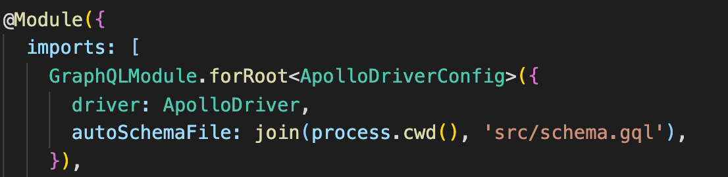
Importing GraphQL
Under src inside our repo, open the file app.module.ts
This is our application’s “root module”
Inside our imports array add
GraphQLModule.forRoot<ApolloDriverConfig>({
driver: ApolloDriver,
autoSchemaFile: join(process.cwd(), 'src/schema.gql'),
})

Slide 24
Creating A New Doctors Module
Remember, Nest follows a modular architecture pattern
Using the Nest cli, inside the terminal type
nest generate module doctors
or
g
(It’s short for generate)
Then run
nest g service doctors
and
nest g resolver doctors
*** Note if you still have the app.module.ts file open, you can see the module being automatically added inside your imports array DoctorsModule

Slide 25
Creating A Doctor Entity Type
Under the doctors folder inside your projects explorer view, create a new file doctor.entity.ts
Create a doctor entity class.
Specify it as an object type for GraphQL.
Create 3 properties/fields for this object type
Id- To keep it simple, make it an Int
Name- a string
Type- a string and is optional
We must provide a configuration object so GraphQL knows it can be nullable
We will use Type optionally to specify the type of doctor (e.g., Dentist)

Slide 26
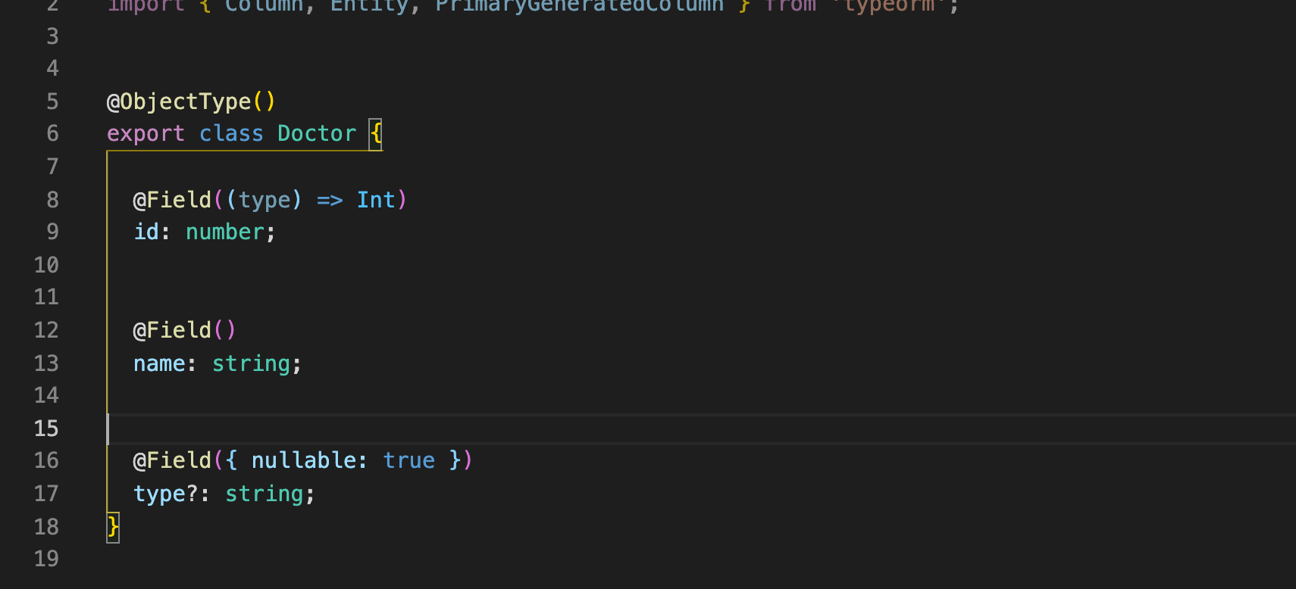
What Our Final Doctor Entity Looks Like
import { Field, Int, ObjectType } from '@nestjs/graphql';
@ObjectType()
export class Doctor {
@Field((type) => Int)
id: number;
@Field()
name: string;
@Field({ nullable: true })
type?: string;
}

Slide 27
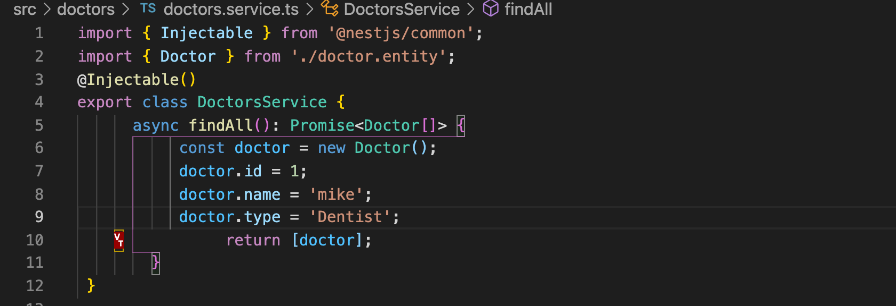
NestJS Sample Query
Inside our Doctors service, create a findAll method that is of type Promise and returns an array of doctors
import { Injectable } from '@nestjs/common’;
import { Doctor } from './doctor.entity';
@Injectable()
export class DoctorsService {
async findAll(): Promise<Doctor[]> {
const doctor = new Doctor();
doctor.id = 1;
doctor.name = 'mike’;
doctor.type = 'Dentist’;
return [doctor];
}
}

Slide 28
Moving Back To Our Doctors Resolver
Now we go back into our doctors resolver so we can utilize the service method we just created.
Inside our doctors resolver, create a constructor that takes in a readonly doctorsService of type DoctorsService:
@Resolver()
export class DoctorsResolver {
constructor(private doctorsService: DoctorsService) { }
}

Slide 29
Resolver Query
Now we create a query method inside of our resolver named doctors
type Promise
promises to return an array of Doctors
This method utilizes the constructor service
this.doctorsService.(insert a service method name here)
*** Note, make sure the Query is imported from nestjs/graphql not from nestjs/common.

Slide 30
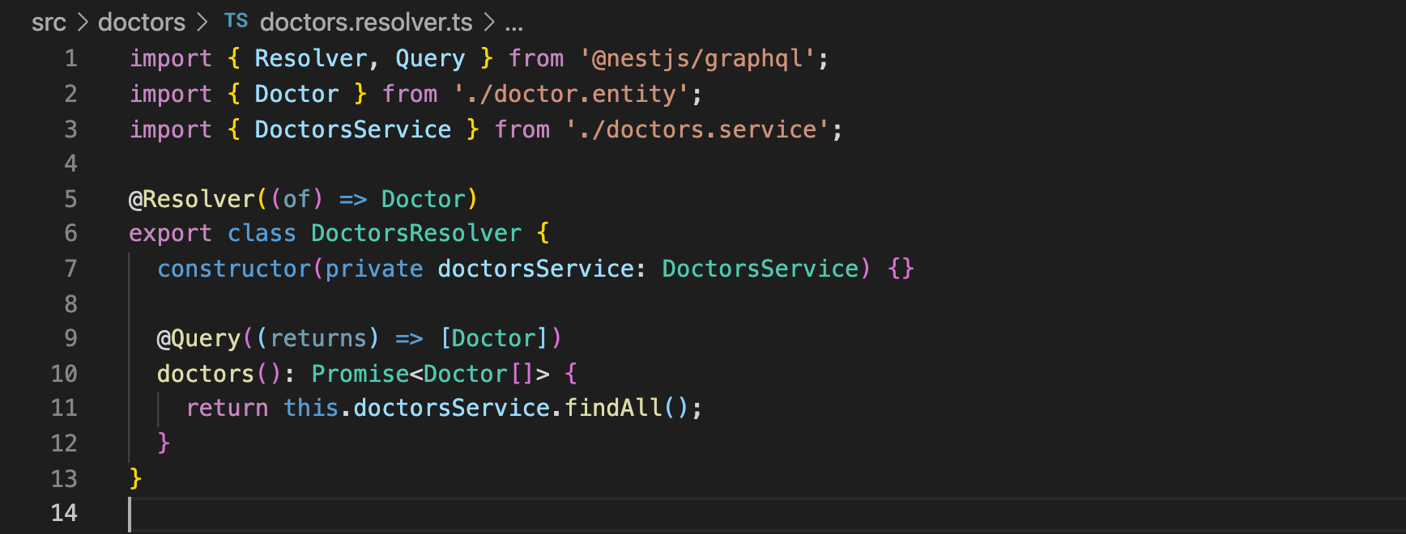
What Our Resolver Looks Like Now…
import { Resolver, Query } from '@nestjs/graphql';
import { Doctor } from './doctor.entity';
import { DoctorsService } from './doctors.service';
@Resolver((of) => Doctor)
export class DoctorsResolver {
constructor(private doctorsService: DoctorsService) {}
@Query((returns) => [Doctor])
doctors(): Promise<Doctor[]> {
return this.doctorsService.findAll();
}
}

Slide 31
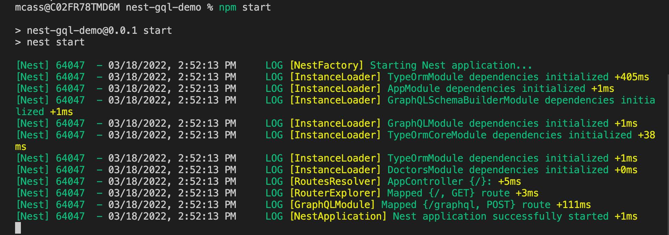
Testing Our App At This Point…
npm start
Should see something like this:

Slide 32
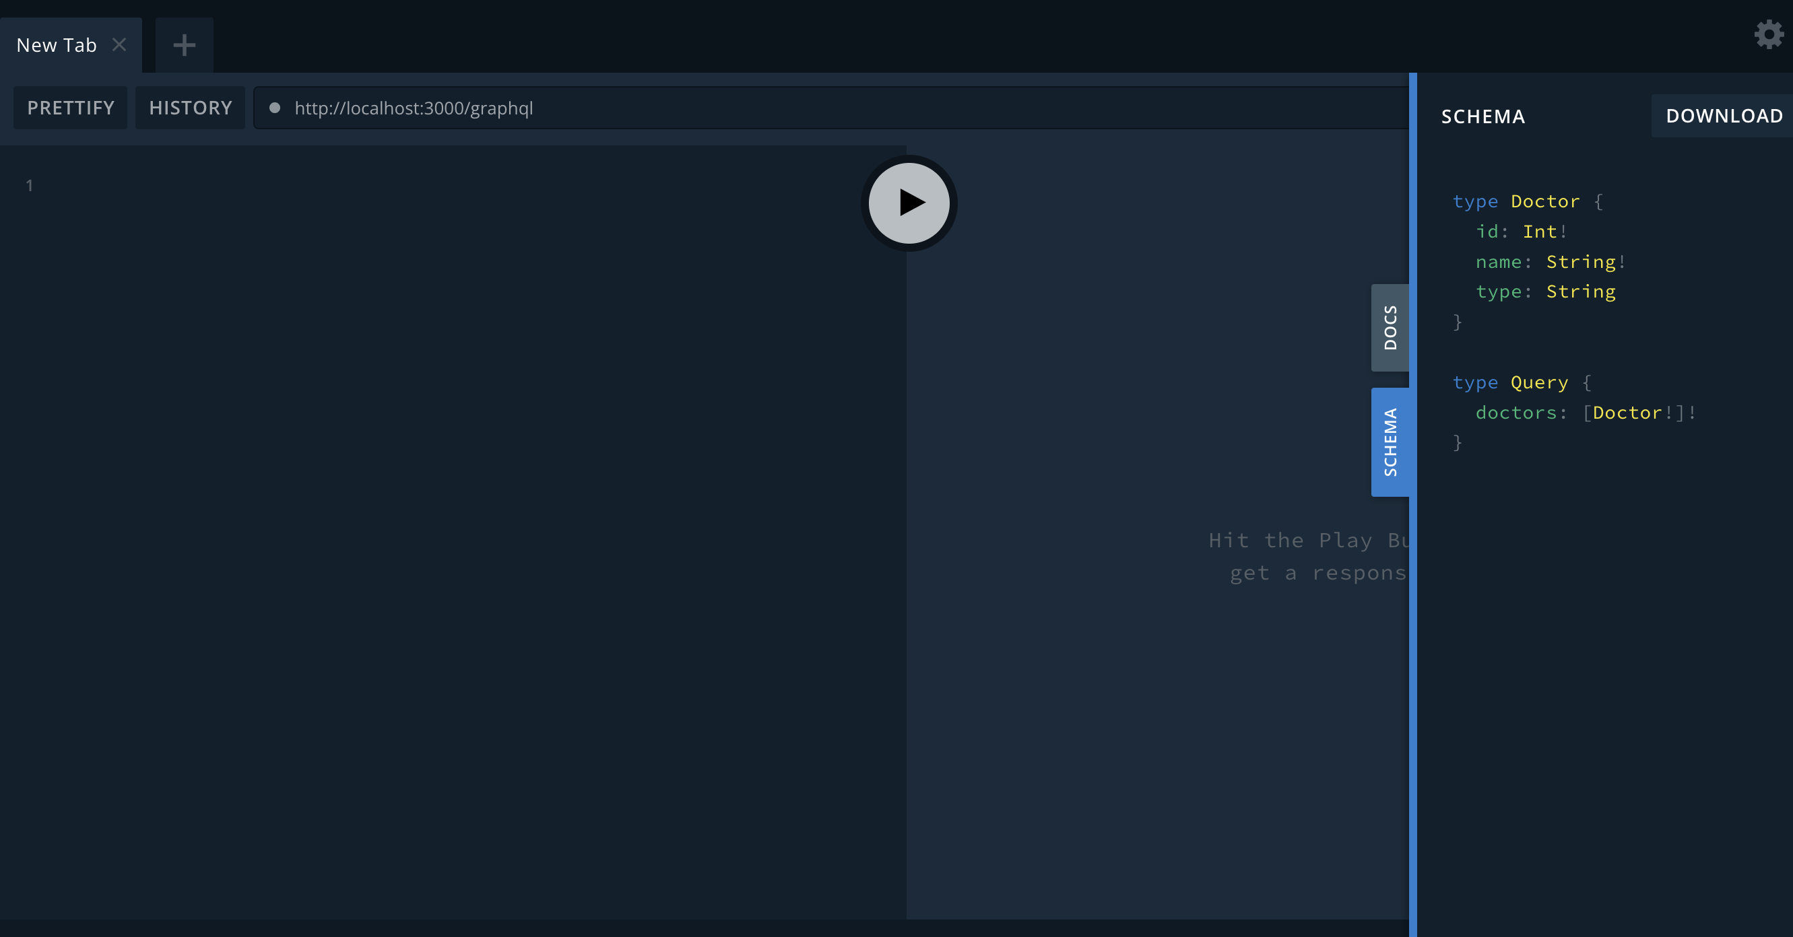
If You Got It Working…
Nest auto generated our schema under source (“src”)
If we go to localhost:3000/graphql in our browser, we should see the playground
We should also see our schema
Try running
query{
doctors{
name
type
}
}

Slide 33
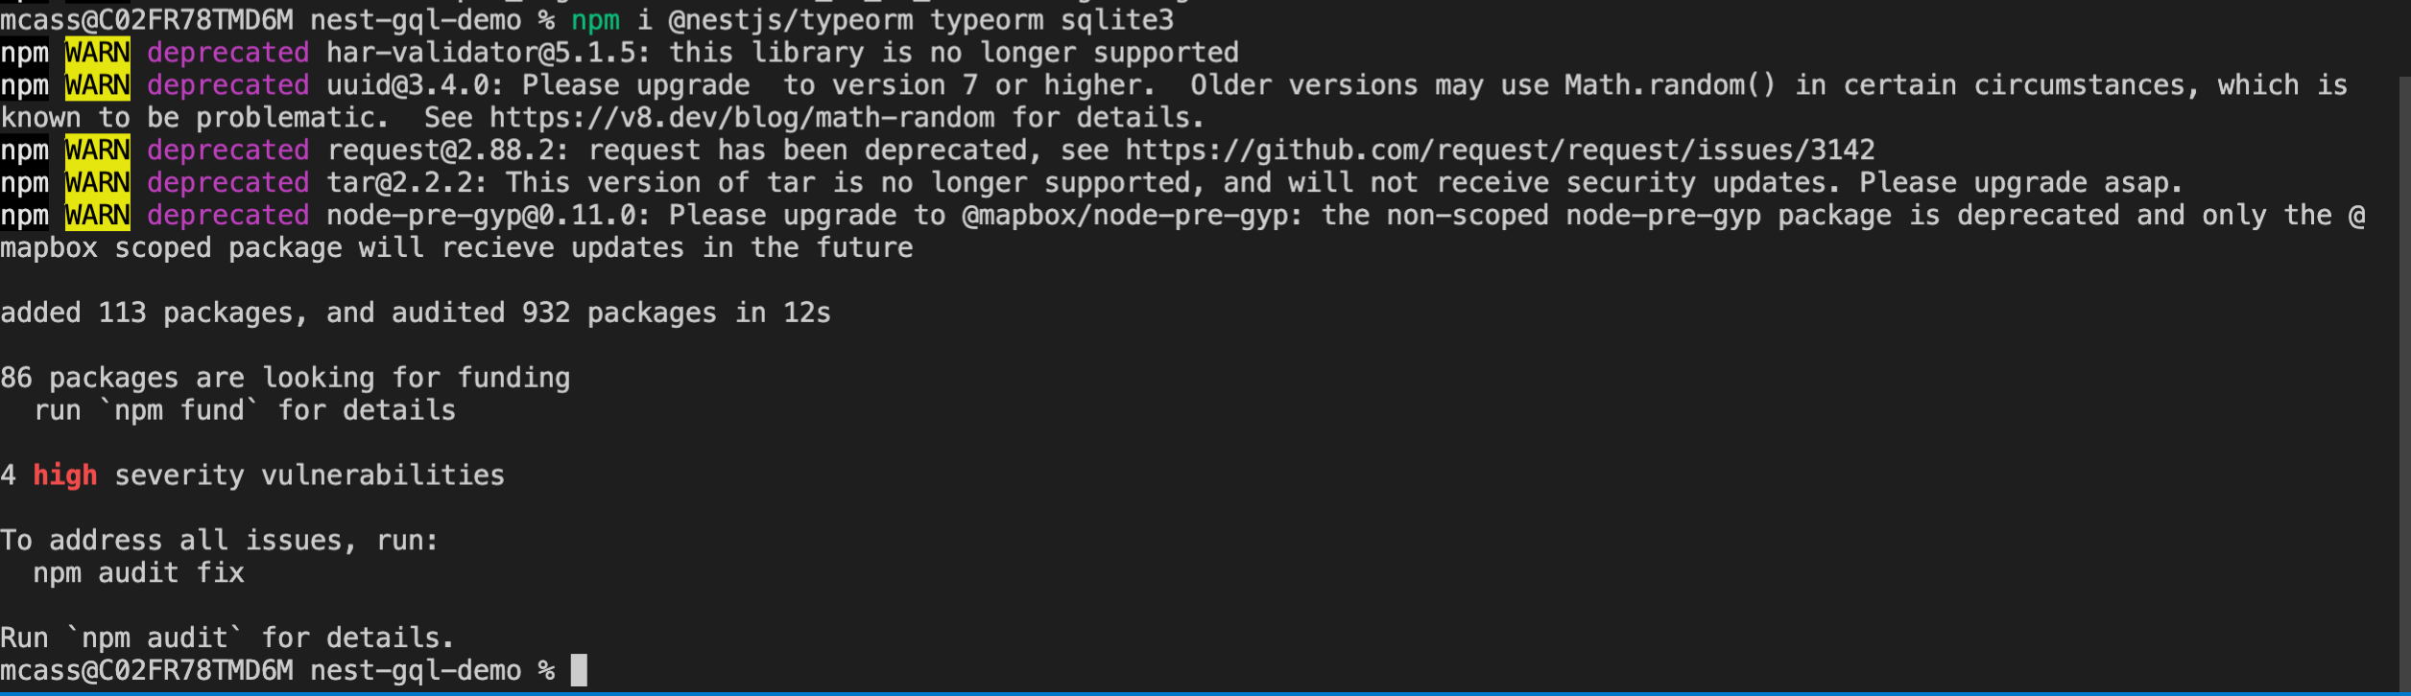
NestJS Database Integration
For Part 2 of our lab, we utilize SQL-lite in memory and TypeORM to show how NestJS works with sql type databases
See TypeORM- Repository API for more details
Run from terminal npm i @nestjs/typeorm typeorm sqlite3

Slide 34
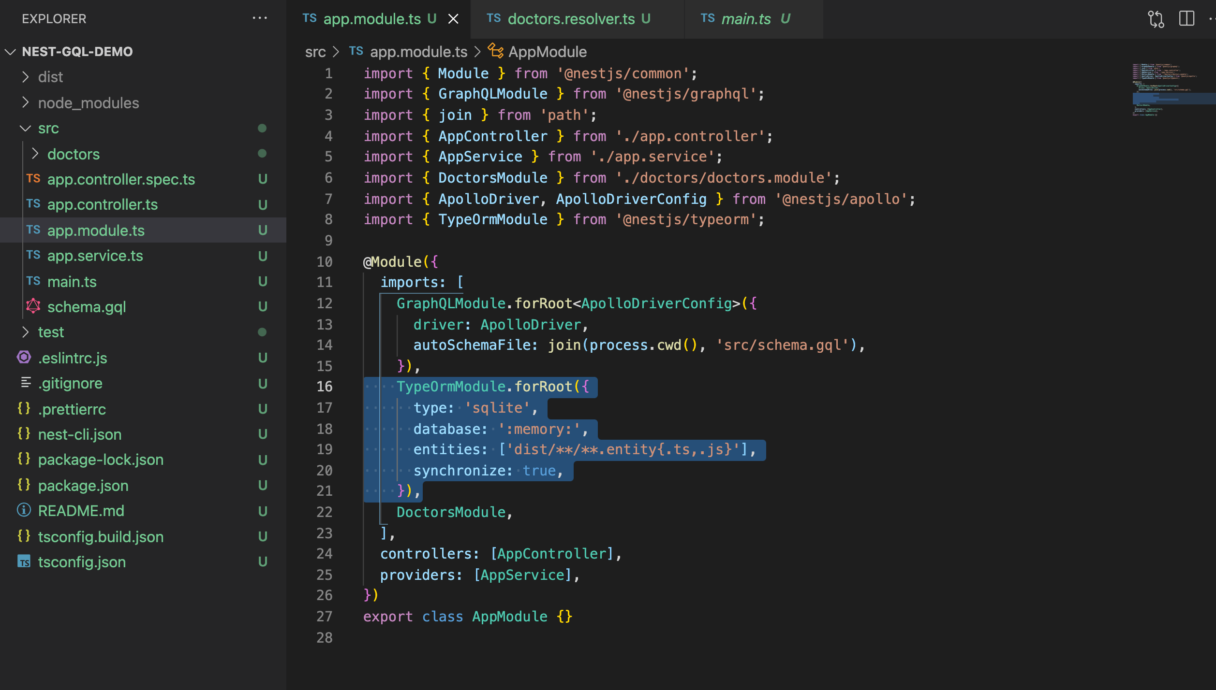
Add TypeORM & SQL Lite To Our App
Go to our applications root module
Inside our imports array, add the TypeOrmModule along with a configuration object that contains the properties needed to utilize SQL Lite in memory, along with where to find our entities
TypeOrmModule.forRoot({
type: 'sqlite',
database: ':memory:',
entities: ['dist/**/*.entity{.ts,.js}'],
synchronize: true,
}),

Slide 35
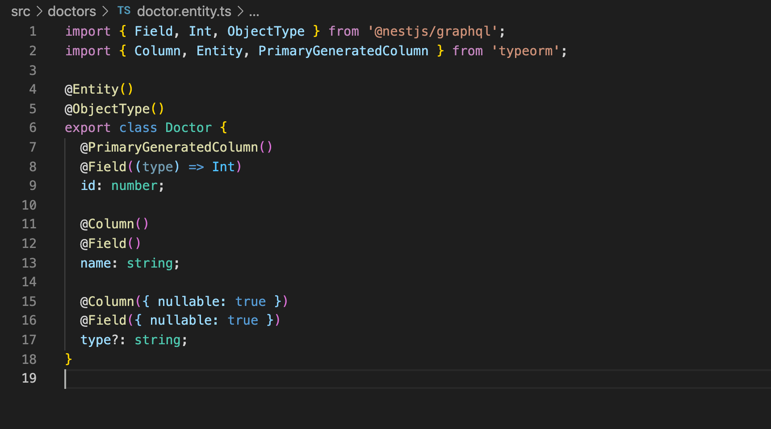
Next Modify Our Existing Doctor Entity
Open our Doctor Entity file
Modify it to work with our
Object type for GraphQL
Database table

Slide 36
Next Modify Our Existing Doctor Entity
import { Field, Int, ObjectType } from '@nestjs/graphql';
import { Column, Entity, PrimaryGeneratedColumn } from 'typeorm';
@Entity()
@ObjectType()
export class Doctor {
@PrimaryGeneratedColumn()
@Field((type) => Int)
id: number;
@Column()
@Field()
name: string;
@Column({ nullable: true })
@Field({ nullable: true })
type?: string;
}

Slide 37
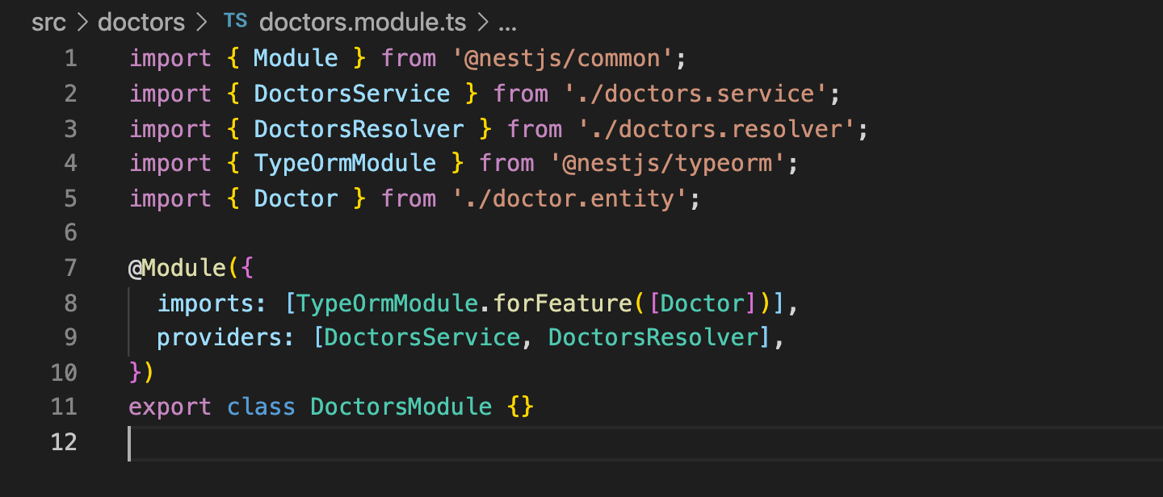
Add TypeORM To Our Doctors Module
Go into our Doctors module file.
Within our imports array, we are going to add a new import TypeORM module for feature, which takes in an array of entities, and in our case the doctor entity.
Add the following code inside our imports array:
[TypeOrmModule.forFeature([Doctor])]

Slide 38
Injecting Our Doctors Repository
Go back into our Doctors service
Add our Doctors repository inside our services constructor.

Slide 39
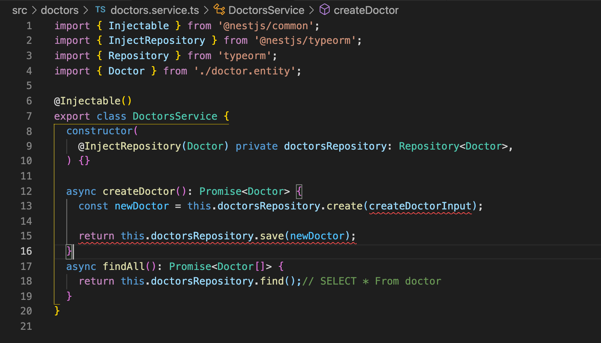
Create New Methods Inside Doctors Service
We will create 2 new methods inside our Doctors service to work with our Doctors repository:
Creating a doctor
Finding all doctors
async createDoctor(createDoctorInput): Promise<Doctor> {
const newDoctor = this.doctorsRepository.create(createDoctorInput);
return this.doctorsRepository.save(newDoctor);
}
async findAll(): Promise<Doctor[]> {
return this.doctorsRepository.find();// SELECT * From doctor
}

Slide 40
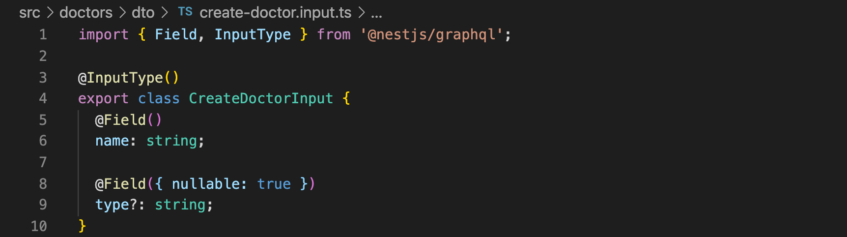
Creating a DTO
A DTO is a Data Transfer Object, the shape of how information is sent into our application.
We will create a new folder in our doctor's module named dto
Within dto we create a new file called create-doctor.input.ts
The code for our DTO :
import { Field, InputType } from '@nestjs/graphql';
@InputType()
export class CreateDoctorInput {
@Field()
name: string;
@Field({ nullable: true })
type?: string;
}

Slide 41
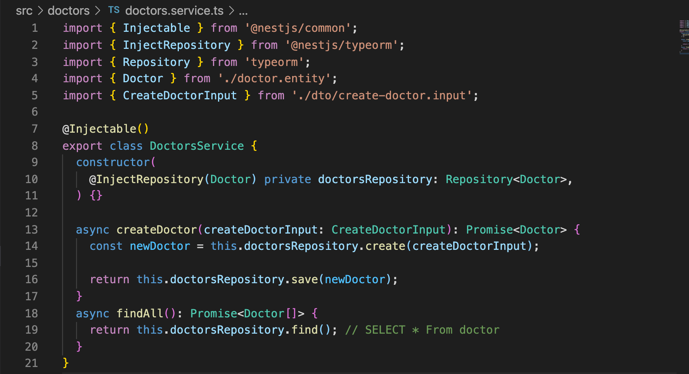
Back Inside Our Doctors Service
We can now utilize the newly created DTO CreateDoctorInput inside our createDoctor service method for its parameter.
Note: Red squiggles are gone!

Slide 42
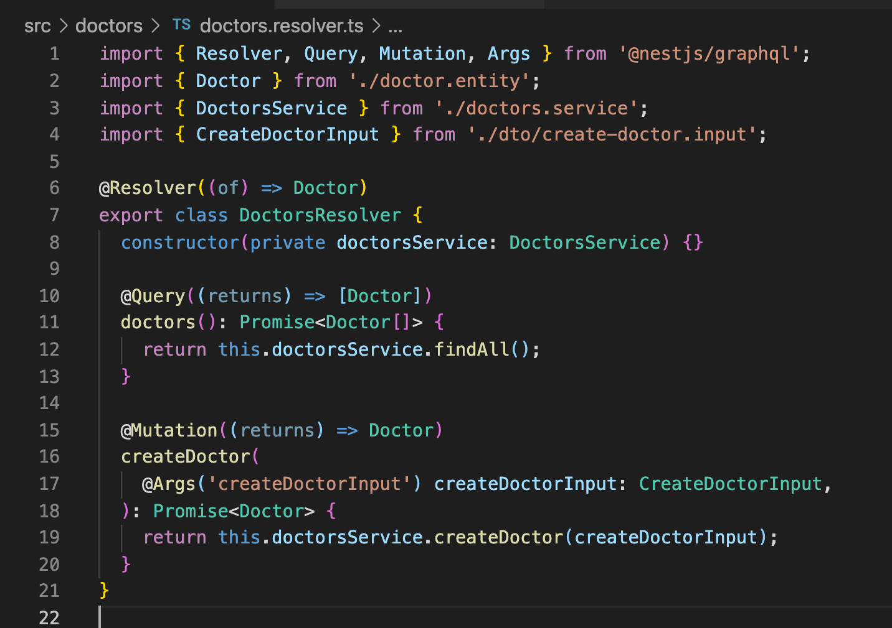
Adding A Mutation To Our Doctors Resolver
Open our doctors resolver
Add a new mutation for creating doctors.
Takes in an argument/parameter create doctor input DTO we created previously.
Returns a call to our newly created service method create doctor that adds a new doctor to our in-memory database.
Code for the new mutation:
@Mutation((returns) => Doctor)
createDoctor(
@Args('createDoctorInput') createDoctorInput: CreateDoctorInput,
): Promise<Doctor> {
return this.doctorsService.createDoctor(createDoctorInput);
}

Slide 43
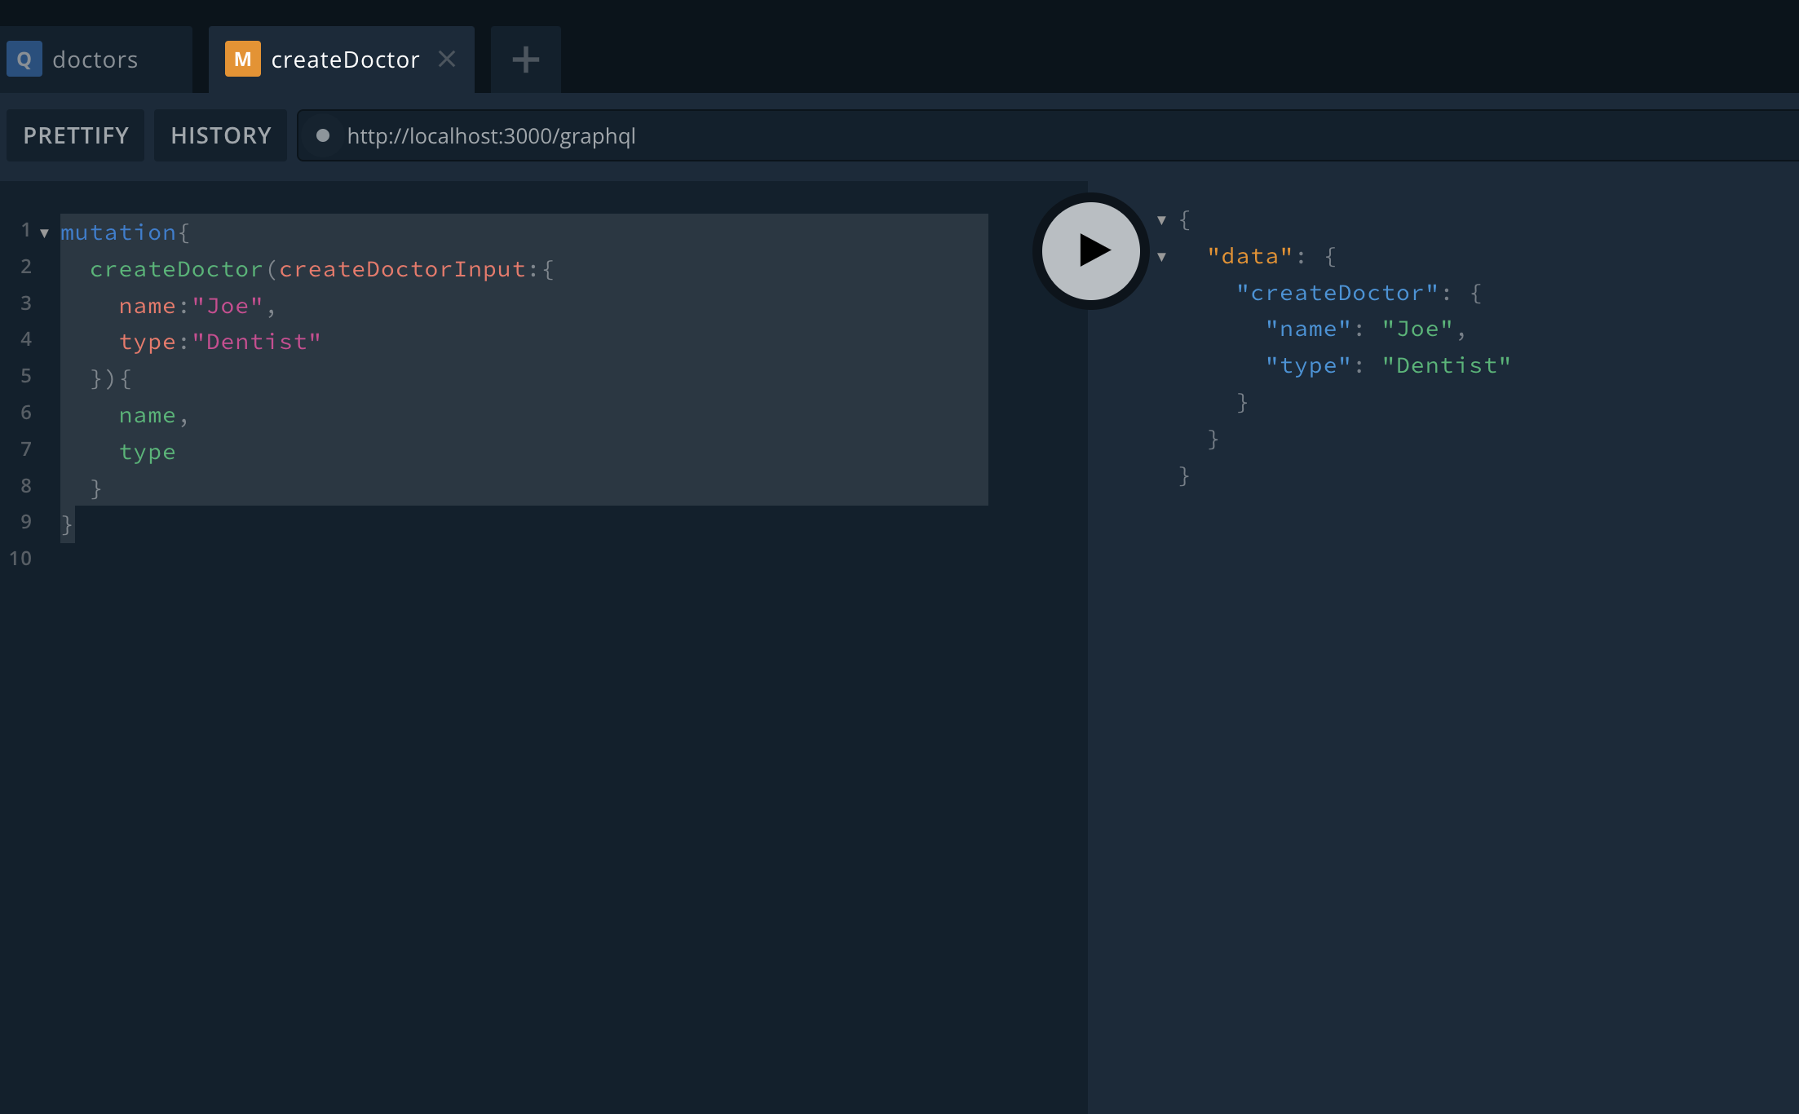
Testing It All Out
Now that we set up our application to utilize TypeORM and an in-memory database, test the new method we added for creating a new doctor in the browser’s playground
Go to http://localhost:3000/graphql
Open a new tab in playground and enter:
mutation{
createDoctor(createDoctorInput:{
name:"Joe",
type:"Dentist"
}){
name,
type
}
}

Slide 44
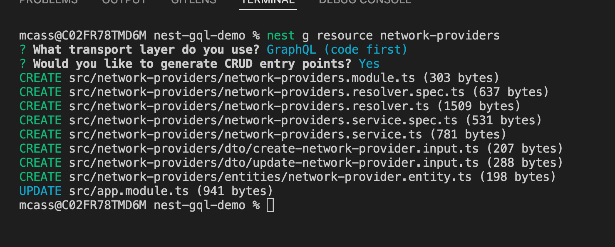
Adding A New Entity: Network Providers
As I mentioned earlier, the NestJS CLI is awesome!
To create a new module for new entities with all the needed boilerplate code, run the command
nest g resource new-module-name
and in our case network-providers
A prompt asks what transport layer you use
Select GraphQL (code first)
Another prompt asks whether you want to generate all the CRUD entry points
Type y for yes

Slide 45
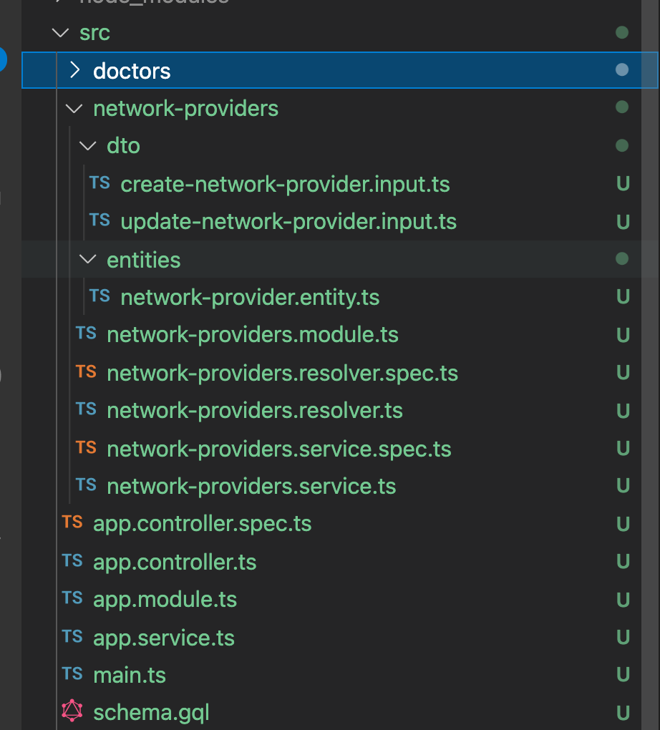
So, What Happened?
The Nest CLI created everything we created in the last part of this lab in a matter of seconds
Specifically, it created
Module
Resolver
Entity
DTO’s
All the spec files for Jest unit testing.

Slide 46
Refactoring The Boilerplate Code
A few things remain to be fixed in order to work with our use case
Service code is not wired up with TypeORM
It just returns example strings
We must
Refactor entities along with the DTO’s to reflect the fields we need
Establish relationships between the two entities

Slide 47
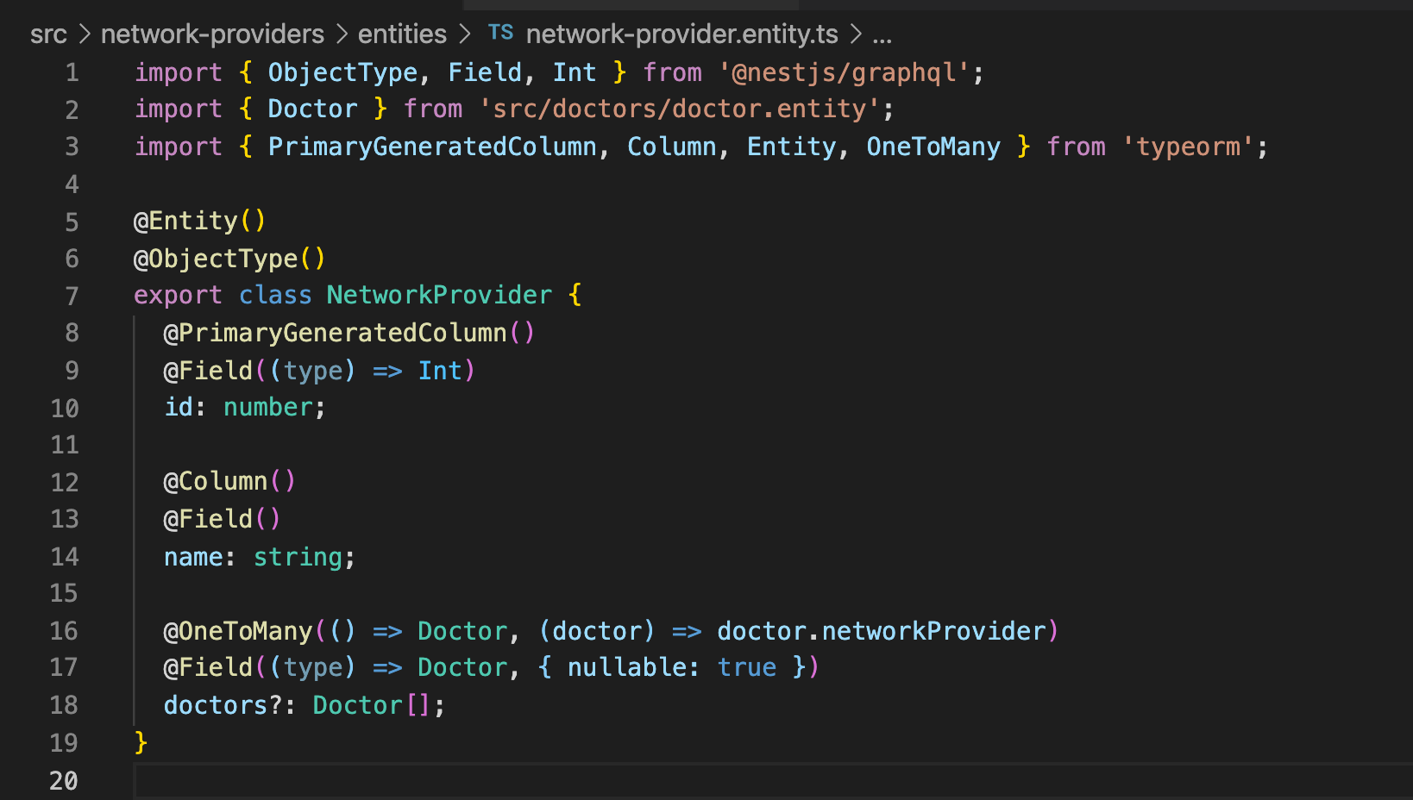
Modifying Network-Provider Entity
First, we create the proper fields for the Network-Provider
Id of type number
name of type string
doctors of type array of doctors
Network Providers have a One-To-Many relationship to Doctors

Slide 48
Final Code for Network-Provider Entity
import { ObjectType, Field, Int } from '@nestjs/graphql';
import { Doctor } from 'src/doctors/doctor.entity';
import { PrimaryGeneratedColumn, Column, Entity, OneToMany } from 'typeorm’;
@Entity()
@ObjectType()
export class NetworkProvider {
@PrimaryGeneratedColumn()
@Field((type) => Int)
id: number;
@Column()
@Field()
name: string;
@OneToMany(() => Doctor, (doctor) => doctor.networkProvider)
@Field((type) => Doctor, { nullable: true })
doctors?: Doctor[];
}

Slide 49
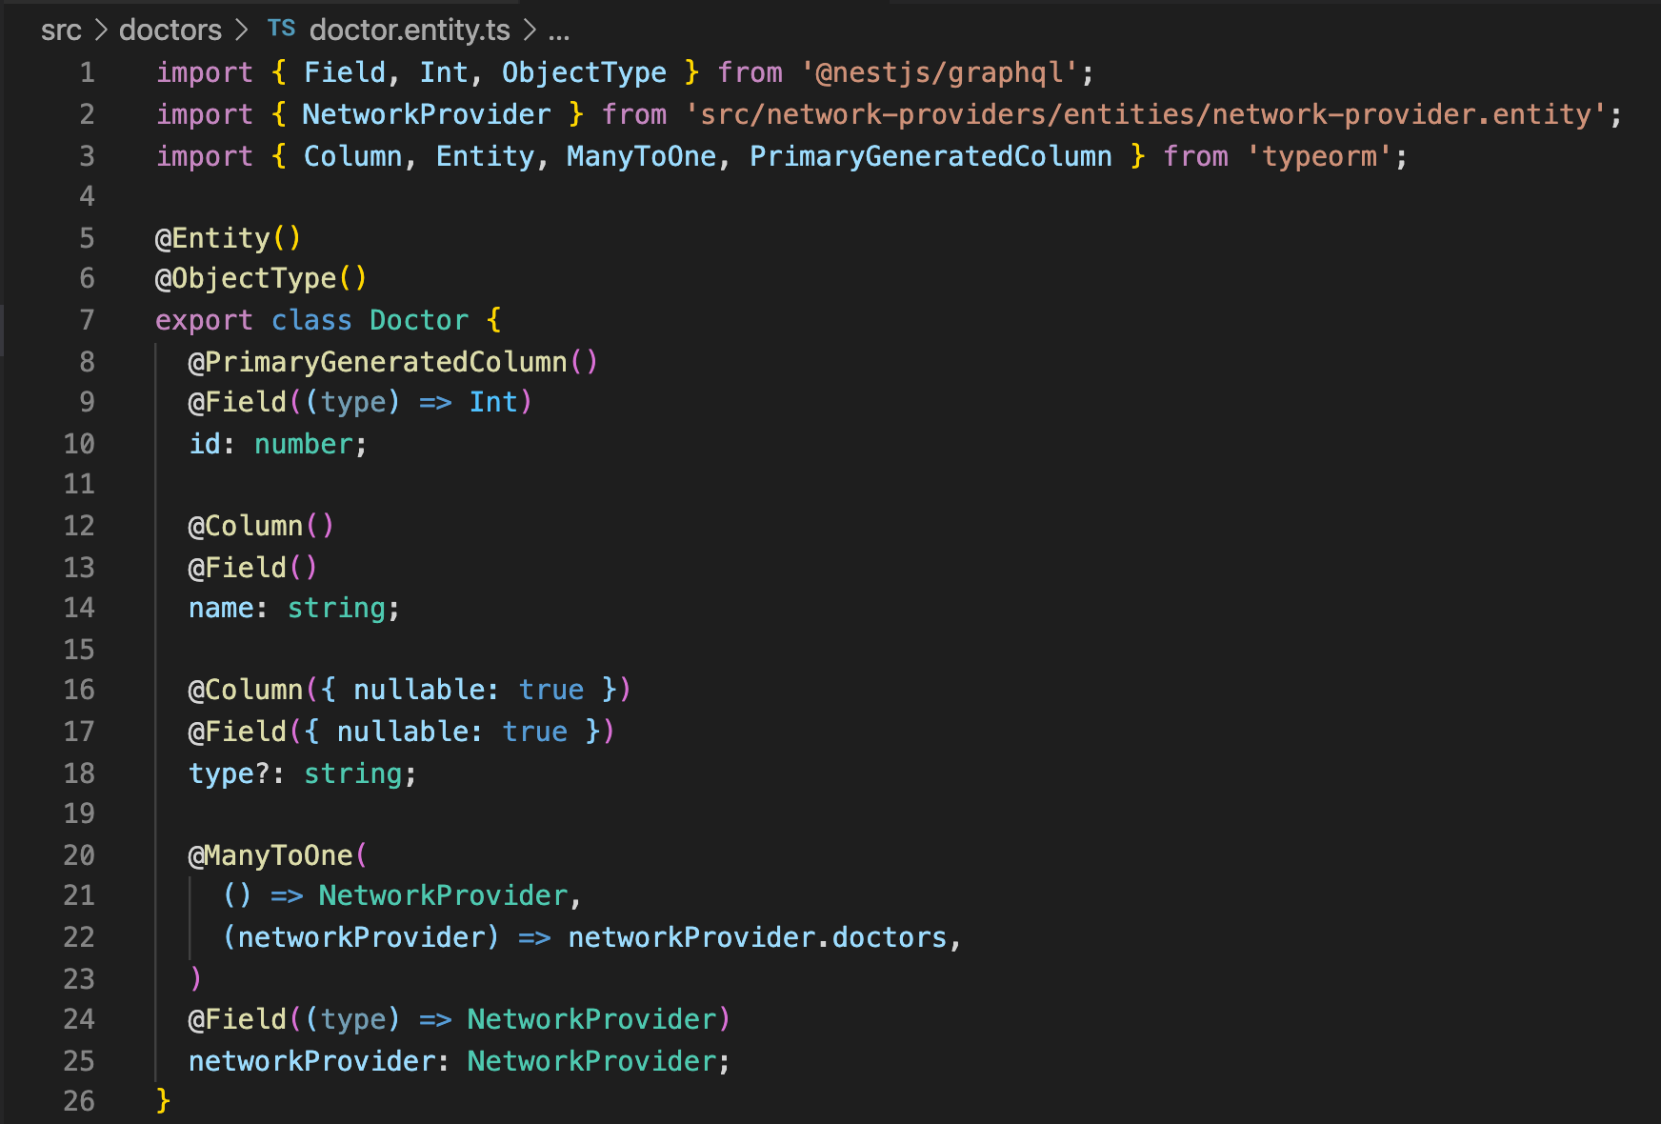
Adding Network Providers To Doctor Entity
To fix the relationship between the doctor entity and the newly created Network-Provider Entity, we need to add the field networkProviders.
Doctors' entity has a Many-To-One relationship with Network-Providers
Code:
@ManyToOne(
() => NetworkProvider,
(networkProvider) => networkProvider.doctors,
)
@Field((type) => NetworkProvider)
networkProvider: NetworkProvider;

Slide 50
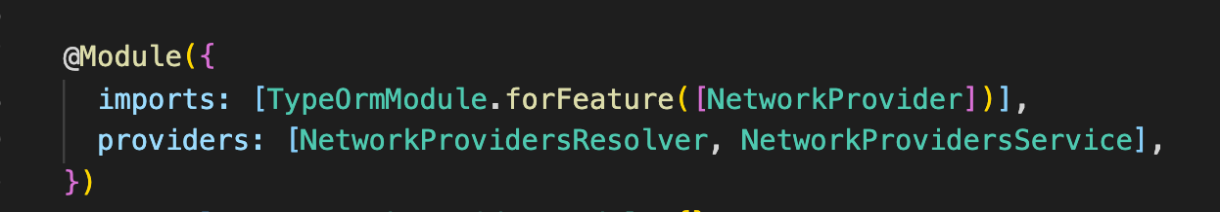
Adding TypeORM To Network-Providers Module
As we did with our Doctors module, in our Network-Providers Module we add TypeOrmModule to our imports array.
Code:
imports: [TypeOrmModule.forFeature([NetworkProvider])],
providers: [NetworkProviderResolver, NetworkProvidersService],
})

Slide 51
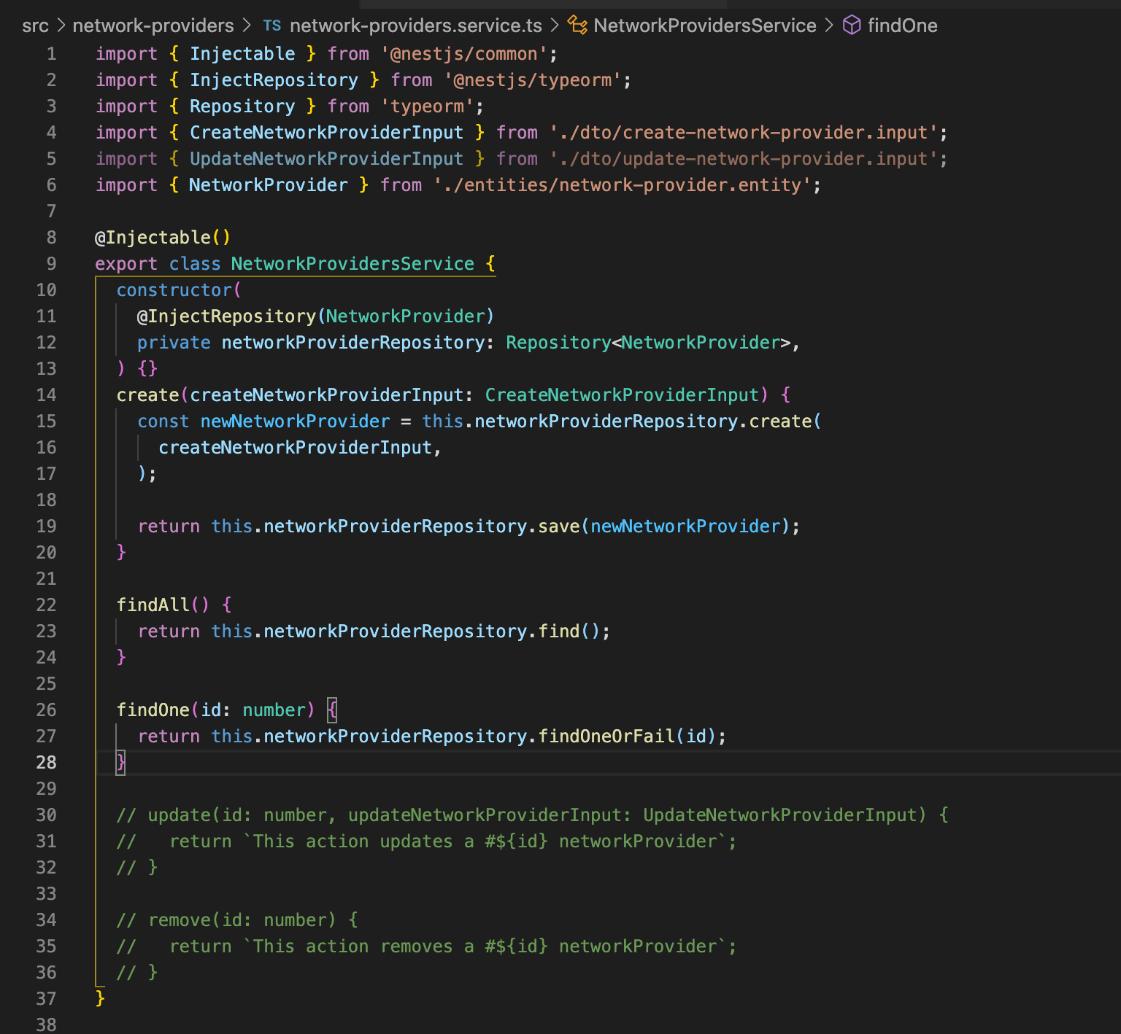
Network-Providers Service
First, we “inject” our Network-Providers repository into our constructor
Then we modify our methods appropriately to work against our repository.

Slide 52
Final Code For Network-Providers Service *Imports are left out but can be auto imported
@Injectable()
export class NetworkProvidersService {
constructor(
@InjectRepository(NetworkProvider)
private networkProviderRepository: Repository<NetworkProvider>,
) {}
create(createNetworkProviderInput: CreateNetworkProviderInput) {
const newNetworkProvider = this.networkProviderRepository.create(
createNetworkProviderInput,
);
return this.networkProviderRepository.save(newNetworkProvider);
}
findAll() {
return this.networkProviderRepository.find();
}
findOne(id: number) {
return this.networkProviderRepository.findOneOrFail(id);
}
}

Slide 53
Get Network-Provider Method
We can utilize our Network-Provider service from within our Doctors service to get the network-provider associated with that Doctor
Go back into our Network-Provider module and add an export property: exports: [NetworkProvidersService]
Now the Network Providers Service can be imported in any other module.
Next import the NetworkProvidersModule inside of our imports array found inside of our Doctors Module.
Now Doctors Module can access our NetworkProvidersService and all its methods.

Slide 54
Last Step, Require a Network-Provider When Creating A Doctor
Add networkProviderId Field() into the createDoctorInput as well as the Doctor Entity.
Add a method inside the Doctors Service findNetworkProvider
Add to our Doctors Resolver a Resolve Field Method so the resolver can call our newly created service method

Slide 55
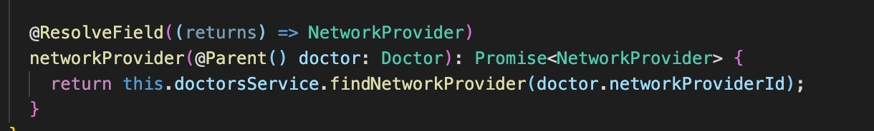
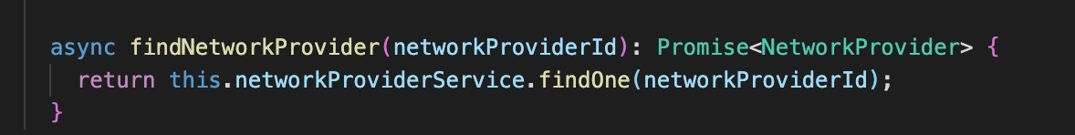
Code For These New Methods
Code for Doctors Resolver:
@ResolveField((returns) => NetworkProvider)
networkProvider(@Parent() doctor: Doctor): Promise<NetworkProvider> {
return this.doctorsService.findNetworkProvider(doctor.networkProviderId);
}
Code for Doctors Service:
async findNetworkProvider(networkProviderId): Promise<NetworkProvider> {
return this.networkProviderService.findOne(networkProviderId);
}

Slide 56
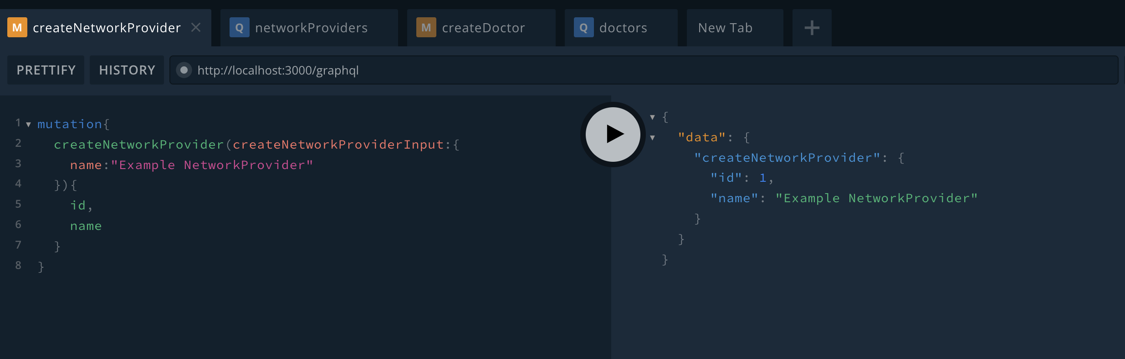
Testing Everything Out
Go to http://localhost:3000/graphql
Test Create Network Provider Mutation

Slide 57
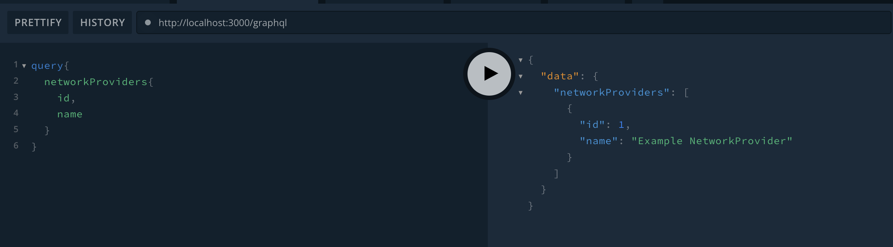
Testing get all network-providers

Slide 58
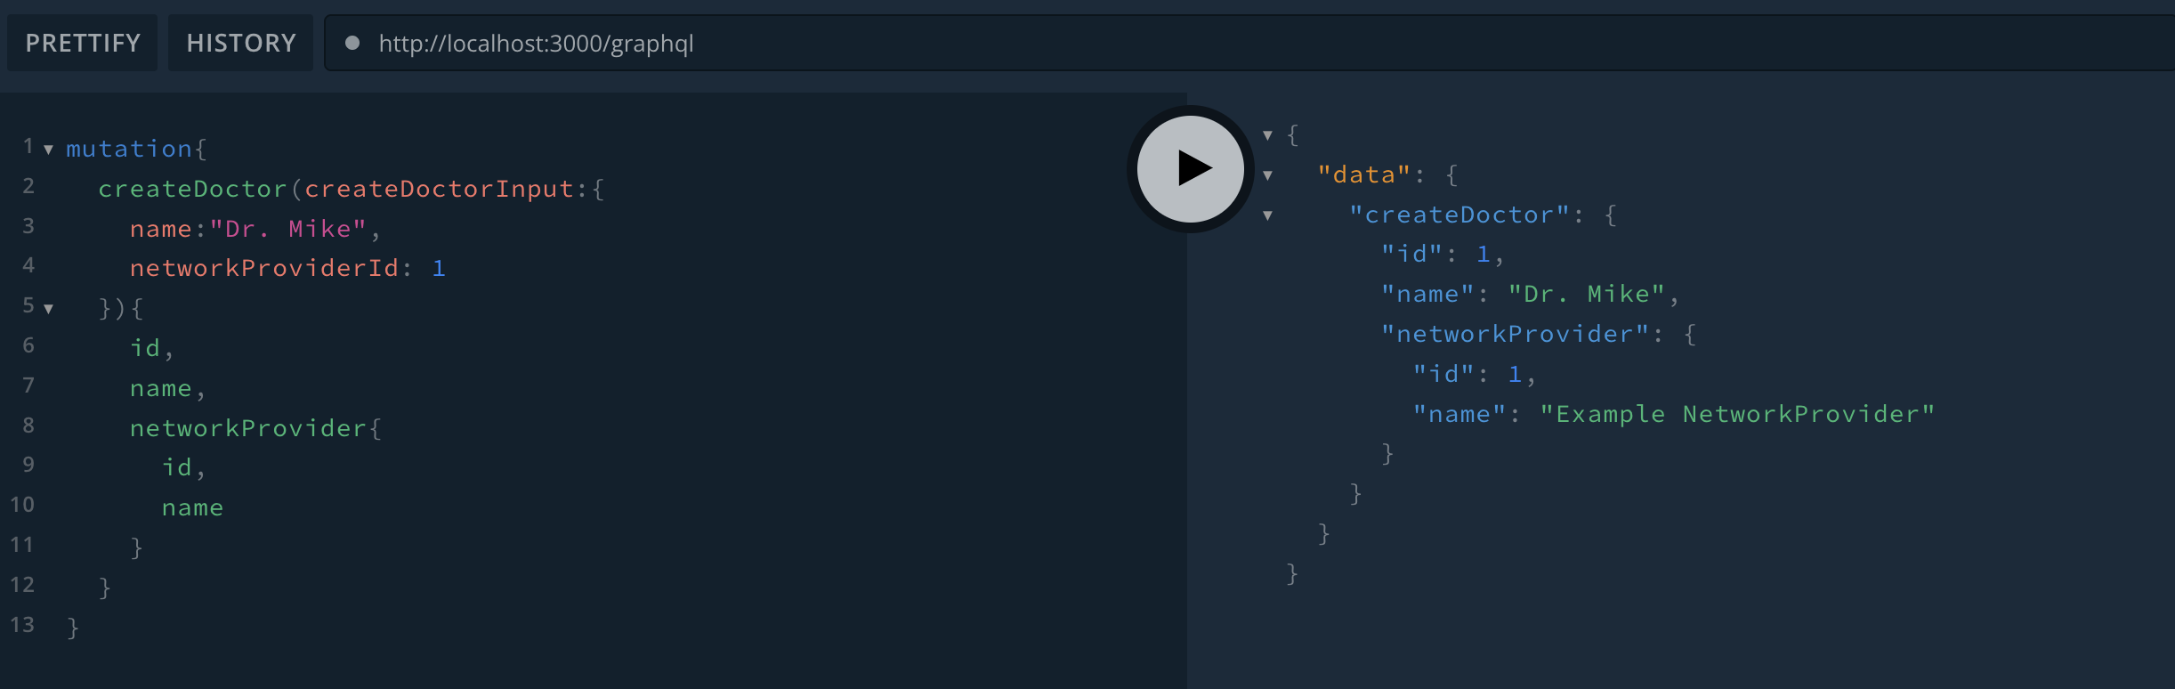
Testing create Doctor

Slide 59
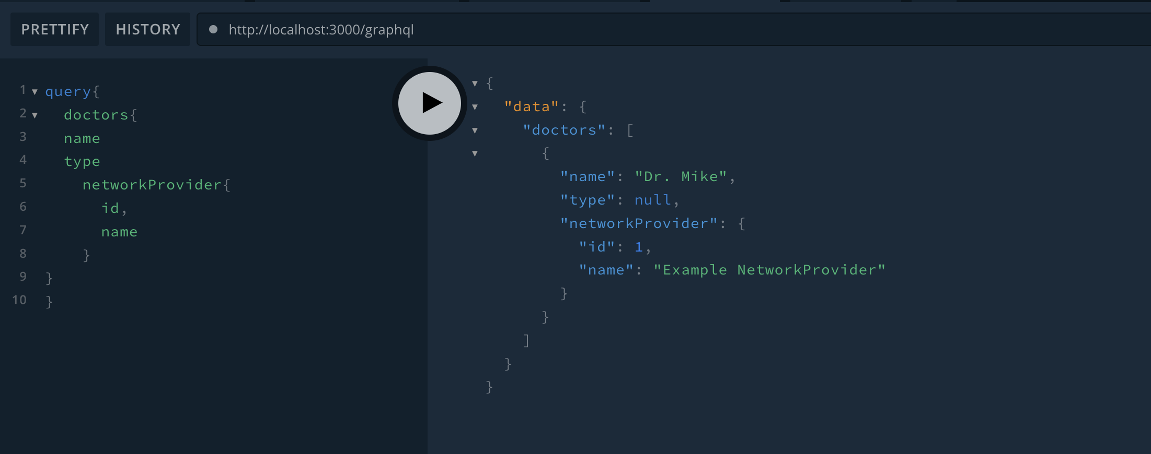
Testing get all Doctors

Slide 60
Questions?

